Slide 1

Automatic Alternative Image Recognition to Voice

Slide 2
Phan Trung Thành (Leader)
Nguyễn Vũ Hoàng Sơn
Võ Hà Quân
Nguyễn Cao Duy (Dropped Out)
Supervisor
Kiều Trọng Khánh

Slide 3
Outline
01
Introduction
02
Problem
03
Our Solution
04
Main features
05
Future plan
06
Technologies - Devlopment Environment

Slide 4
Introduction
Introduction

Slide 5


Introduction
Notes:
cuộc sống hiện đại => có nhiều thiết bị hiện đại => smart phone

Slide 6
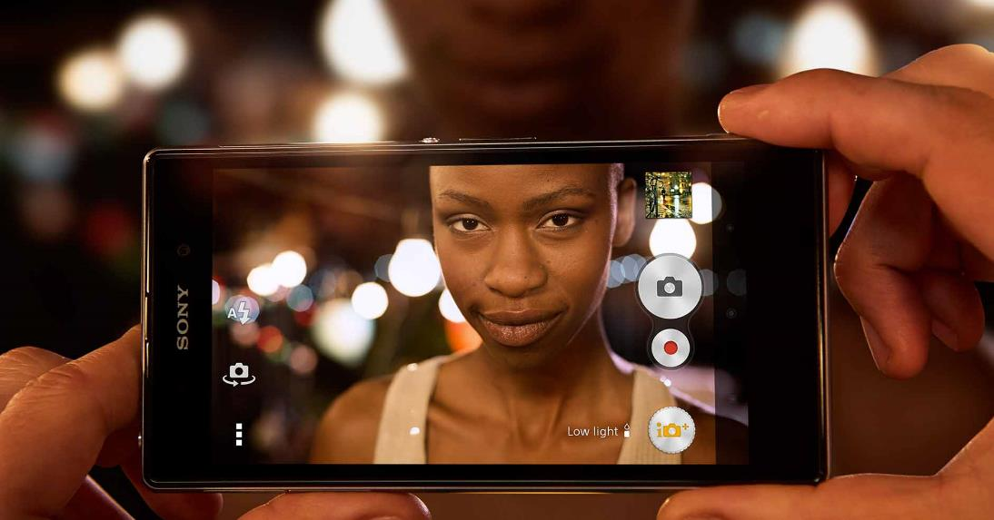

Introduction
Capture Pictures
Voice Control
Notes:
hỗ trợ nhiều tính năng....

Slide 7

Introduction
Notes:
Đối với người mù thì không đơn giản như thế

Slide 8

Introduction
Notes:
Khó tương tác vs công nghệ, vd như điện thoại smartphone

Slide 9

Introduction
Notes:
Laptop

Slide 10

Introduction
Notes:
Ngoài những cái kể trên thì còn Khó khăn trong giao tiếp hàng ngày

Slide 11
Introduction
How can we use Technologies to improve their Life ?

Slide 12

Introduction

Slide 13
Introduction
Help blind Person interact and communicate with others easily.

Slide 14
Introduction
Help blind Person interact and communicate with others easily.
Help blind Person fulfill everyday task that seems impossible.

Slide 15
Introduction
Problems

Slide 16

Problems
Notes:
Liệt kê những ứng dụng đã có

Slide 17
Problems
Pros:
Detect everyday life objects through taken pictures.
Ex: Money, colors…

Slide 18
Problems
Pros:
Detect everyday life objects through taken pictures.
Ex: Money, colors…
Cons
Poor performance
Detect object only
Cannot train to identify new object.
No Voice Control.
Only support English.

Slide 19

Problems

Slide 20
Problems
Pros:
High accuracy.
Can identify various things.
Control through interact with volunteer.

Slide 21
Problems
Pros:
High accuracy.
Can identify various things.
Control through interact with volunteer.
Cons:
Always need volunteers.
No Voice control.
Security problems.

Slide 22
Introduction
Our Solution

Slide 23

Our Solution
Identify Person

Slide 24

Our Solution
Identify Person
Identify Objects

Slide 25
Our Solution
Identify Person
Identify Objects
Training

Slide 26

Our Solution
Identify Person
Identify Objects
Training
Voice Control
Notes:
#chua noi den voice regconition

Slide 27
Person
Identification
Introduction

Slide 28
Person Identification
Problem

Slide 29

Person Identification
Problem
Mr. Son

Slide 30

Person Identification
Problem
Hello !
Mr. Son
Mr. Thanh

Slide 31
Person Identification
Problem
Who is this ?
Hello !
Mr. Son
Mr. Thanh

Slide 32
Person Identification
Problem
Who is this ?
How can Mr. Son knows who is the person calling him ?
Notes:
Làm sao biết người đang gọi mình là ai
Làm sao chào hỏi người đó như thế nào

Slide 33
Person Identification
Problem
Who is this ?
How can Mr. Son knows who is the person calling him ?
How can Mr. Son greeting that person ?
Notes:
Làm sao biết người đang gọi mình là ai
Làm sao chào hỏi người đó như thế nào

Slide 34
Person Identification
Our Proposal

Slide 35

Person Identification
Our Proposal
System

Slide 36
Person Identification
Our Proposal
Detect Person
System

Slide 37
Person Identification
Our Proposal
Describe the Person back to the blind
Detect Person
System

Slide 38
Person Identification
Our Proposal
Describe the Person back to the blind
Detect Person
System
The blind know who is the Person calling them

Slide 39
Person Identification
Our Proposal
Describe the Person back to the blind
Detect Person
System
User can now greeting the person by their name
The blind know who is the Person calling them

Slide 40
Person Identification
How can we do that ?

Slide 41


Person Identification
How can we do that ?
1. Capture Picture
Camera

Slide 42

Person Identification
How can we do that ?
1. Capture Picture
Camera
System

Slide 43

Person Identification
How can we do that ?
2. Send Image
1. Capture Picture
Camera
System
Microsoft Cognitive Service

Slide 44
Person Identification
How can we do that ?
2. Send Image
1. Capture Picture
Camera
System
3. Response Result
Microsoft Cognitive Service

Slide 45

Person Identification
How can we do that ?
2. Send Image
1. Capture Picture
Camera
System
3. Response Result
Microsoft Cognitive Service
4. Process

Slide 46

Person Identification
How can we do that ?
2. Send Image
1. Capture Picture
Camera
System
3. Response Result
Microsoft Cognitive Service
4. Process
5. Describe
Blind user

Slide 47

Person Identification
How can we do that ?
2. Send Image
1. Capture Picture
Camera
System
3. Response Result
Microsoft Cognitive Service
4. Process
5. Describe
Blind user

Slide 48
Person Identification
Technology

Slide 49

Person Identification
Technology

Slide 50
Person Identification
Technology
Detect Human Faces, Gender, Age

Slide 51
Person Identification
Technology
Detect Human Faces, Gender, Age
Train system to identify a Person

Slide 52
Person Identification
Technology
Detect Human Faces, Gender, Age
Train system to identify a Person
Identify Person Face

Slide 53
Person Identification
Technology
How can a machine detect a Human Face ?

Slide 54
Person Identification
Technology
Understand Human Face

Slide 55
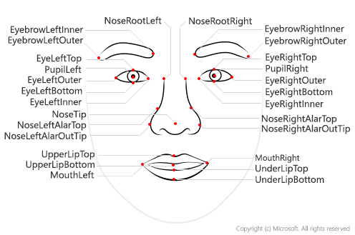
Person Identification
Technology
Understand Human Face

Slide 56

Person Identification
Technology
Understand Human Face

Slide 57
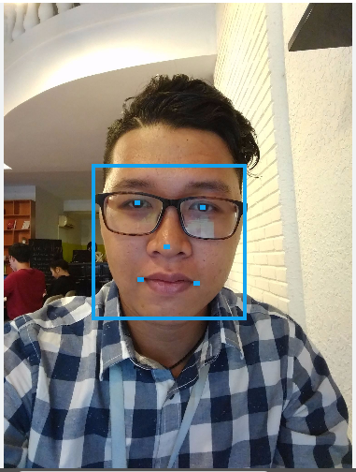
Person Identification
Technology
Understand Human Face

Slide 58
Person Identification
Technology
How it works

Slide 59

Person Identification
Technology
How it works
Input

Slide 60

Person Identification
Technology
How it works
Input
1. Convert to black and white

Slide 61

Person Identification
Technology
How it works
Input
1. Convert to black and white
2. Divide into small parts
Notes:
#nham thuat toan. can coi lai. xem them concept của google: https://developers.google.com/vision/face-detection-concepts
https://medium.com/@ageitgey/machine-learning-is-fun-part-4-modern-face-recognition-with-deep-learning-c3cffc121d78

Slide 62
Person Identification
Technology
How it works

Slide 63

Person Identification
Technology
How it works
3. Scan each pixel

Slide 64
Person Identification
Technology
How it works

Slide 65

Person Identification
Technology
How it works
4. Neural
Networks
Matrix

Slide 66
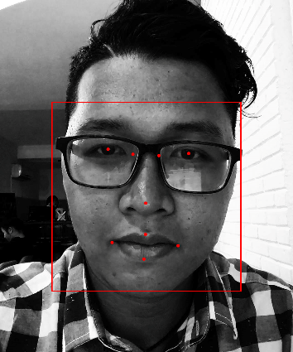
Person Identification
Technology
How it works
5. Algorithms
Matrix
Face landmarks

Slide 67
Person Identification
Demo
Detect a Person

Slide 68
Person Identification
Summary – Demo Detect Person

Slide 69
Person Identification
Summary – Demo Detect Person
User know the gender of the Person in front of them

Slide 70
Person Identification
Summary – Demo Detect Person
User know the gender of the Person in front of them
User know how to greet the Person properly

Slide 71
Person Identification
Problem
Okay cool, but what if I want to know his / her name ?
How can Mr. Son knows exactly who is calling him ?
Notes:
Làm sao biết người đang gọi mình là ai
Làm sao chào hỏi người đó như thế nào

Slide 72
Person Identification
Problem
Okay cool, but what if I want to know his / her name ?
How can Mr. Son knows exactly who is calling him ?
Identify Process
Notes:
Làm sao biết người đang gọi mình là ai
Làm sao chào hỏi người đó như thế nào

Slide 73
Person Identification
Technology
How can Microsoft Cognitive Service Identify a Person ?

Slide 74
Person Identification
Technology
Training Process

Slide 75
Person Identification
Technology
Training Process
Create New Person

Slide 76
Person Identification
Technology
Training Process
Create New Person
Add Person Face

Slide 77
Person Identification
Technology
Training Process
Create New Person
Add Person Face
Training

Slide 78
Person Identification
Technology
Understand Terms

Slide 79
Person Identification
Technology
Understand Terms
Person Group

Slide 80
Person Identification
Technology
Understand Terms
Person Group
Person

Slide 81
Person Identification
Technology
Understand Terms
Person Group
Person
Face

Slide 82
Person Identification
Understand Terms
Person Group

Slide 83
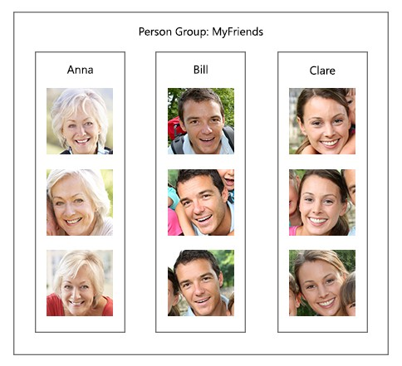
Person Identification
Understand Terms
Person Group

Slide 84
Person Identification
Understand Terms
Person Group
Most important

Slide 85
Person Identification
Understand Terms
Person Group
Most important
Unique for each user

Slide 86
Person Identification
Understand Terms
Person Group
Most important
Unique for each user
Contains up to 1000 Person

Slide 87
Person Identification
Understand Terms
Person

Slide 88
Person Identification
Understand Terms
Person
Belong to a unique Person Group

Slide 89
Person Identification
Understand Terms
Person
Belong to a unique Person Group
Have a unique Person ID

Slide 90
Person Identification
Understand Terms
Person
Belong to a unique Person Group
Have a unique Person ID
Have Name, Description

Slide 91
Person Identification
Understand Terms
Person
Belong to a unique Person Group
Have a unique Person ID
Have Name, Description
Have up to 248 faces.

Slide 92



Person Identification
Understand Terms
Face
Have a unique Persisted Face ID
Hà Quân

Slide 93
Person Identification
Understand Terms
Face
Have a unique Persisted Face ID
Belong to a certain Person
Hà Quân

Slide 94
Person Identification
Technology
Understand Terms

Slide 95
Person Identification
Technology
Understand Terms
Person Group

Slide 96
Person Identification
Technology
Understand Terms
Person Group
Person

Slide 97
Person Identification
Technology
Understand Terms
Person Group
Person
Faces

Slide 98
Person Identification
Technology
Understand Terms
Person Group
Person
Identify Faster
Faces

Slide 99
Person Identification
Technology
Training Process
Create New Person
Add Person Face
Training

Slide 100
Person Identification
Technology
Training Process
Create New Person
Add Person Face
Training

Slide 101
Person Identification
Create New Person
Microsoft Cognitive Service
System
User

Slide 102
Person Identification
Create New Person
Microsoft Cognitive Service
System
1. Input
User
Name
Description

Slide 103
Person Identification
Create New Person
Microsoft Cognitive Service
System
Person Group
Person
1. Input
Name
Description
User
Name
Description

Slide 104
Person Identification
Create New Person
Microsoft Cognitive Service
System
Person Group
Person
2. Create Person
1. Input
Name
Description
User
Name
Description

Slide 105
Person Identification
Create New Person
Microsoft Cognitive Service
System
Person Group
Person Group
Person
Person
2. Create Person
1. Input
Name
Description
Name
Description
Person ID
User
Name
Description

Slide 106
Person Identification
Create New Person
Microsoft Cognitive Service
System
Person Group
Person Group
Person
Person
2. Create Person
1. Input
Name
Description
Name
Description
Person ID
User
Name
Description
3. Person ID

Slide 107
Person Identification
Create New Person
Microsoft Cognitive Service
System
Person Group
Person Group
Person
Person
2. Create Person
1. Input
Name
Description
Person ID
Name
Description
Person ID
User
Name
Description
3. Person ID

Slide 108
Person Identification
Technology
Training Process
Create New Person
2. Add Person Face
3. Training

Slide 109
Person Identification
Technology
Training Process
Create New Person
2. Add Person Face
3. Training

Slide 110
Person Identification
Add Person Face
Microsoft Cognitive Service
System
Person Group
Person Group
Person
Person
Name
Description
Person ID
Name
Description
Person ID
User

Slide 111

Person Identification
Add Person Face
Microsoft Cognitive Service
System
Person Group
Person Group
1. Input
Person
Person
Name
Description
Person ID
Name
Description
Person ID
User

Slide 112
Person Identification
Add Person Face
Microsoft Cognitive Service
System
Person Group
Person Group
1. Input
Person
2. Send
Person
Name
Description
Person ID
Name
Description
Person ID
User
Person ID
Person Group ID

Slide 113
Person Identification
Add Person Face
Microsoft Cognitive Service
System
Person Group
Person Group
1. Input
Person
2. Send
Person
Name
Description
Person ID
Name
Description
Person ID
User
Person ID
Person Group ID
Face

Slide 114
Person Identification
Add Person Face
Microsoft Cognitive Service
System
Person Group
Person Group
1. Input
Person
2. Send
Person
Name
Description
Person ID
Name
Description
Person ID
User
Person ID
Person Group ID
Face
3. Return
Persisted Face ID

Slide 115
Person Identification
Add Person Face
Microsoft Cognitive Service
System
Person Group
Person Group
1. Input
Person
2. Send
Person
Name
Description
Person ID
Name
Description
Person ID
User
Person ID
Face
Face
Person Group ID
Persisted Face ID
3. Return
Persisted Face ID

Slide 116
Person Identification
Technology
Training Process
Create New Person
Add Person Face
3. Training

Slide 117
Person Identification
Technology
Training Process
Create New Person
Add Person Face
3. Training

Slide 118
Person Identification
Training
Microsoft Cognitive Service
System
Person Group
User

Slide 119
Person Identification
Training
Microsoft Cognitive Service
System
Person Group
1. Train
User

Slide 120
Person Identification
Training
Microsoft Cognitive Service
System
Person Group
2. Send
1. Train
Person Group ID
User

Slide 121

Person Identification
Training
Microsoft Cognitive Service
System
Person Group
Person Group
2. Send
1. Train
Person Group ID
User
Train Person Group

Slide 122
Person Identification
Training
Microsoft Cognitive Service
System
Person Group
Person Group
2. Send
1. Train
Person Group ID
User
3. Return Status
4. Notify
Train Person Group

Slide 123
Person Identification
Technology
Training Process
Create New Person
Add Person Face
Training

Slide 124
Person Identification
Demo
Training Unidentified Person

Slide 125
Person Identification
Summary – Demo Training Unidentified Person

Slide 126
Person Identification
Summary – Demo Training Unidentified Person
New Person is successfully added into system.

Slide 127
Person Identification
Summary – Demo Training Unidentified Person
New Person is successfully added into system.
System can now Identify trained Person.

Slide 128
Person Identification
Problem
Okay cool, but what if I want to know his / her name ?
How can Mr. Son knows exactly who is calling him ?
Notes:
Quay trở lại với vấn đề nêu trên => giờ đã có thể nhận diện được đó là ai

Slide 129
Person Identification
Technology
Identifying Process
Detect Human Face

Slide 130
Person Identification
Technology
Identifying Process
Detect Human Face
Identify Face and get Candidates

Slide 131
Person Identification
Technology
Identifying Process
Detect Human Face
Identify Face and get Candidates
Get Person Information

Slide 132
Person Identification
Technology
Identifying Process
Detect Human Face
Identify Face and get Candidates
Get Person Information

Slide 133
Person Identification
Detect Human Face
Microsoft Cognitive Service
System
User

Slide 134

Person Identification
Detect Human Face
Microsoft Cognitive Service
System
1. Capture
User

Slide 135

Person Identification
Detect Human Face
Microsoft Cognitive Service
System
1. Capture
2. Detect API
User

Slide 136
Person Identification
Detect Human Face
Microsoft Cognitive Service
System
1. Capture
2. Detect API
User

Slide 137
Person Identification
Detect Human Face
Microsoft Cognitive Service
System
1. Capture
2. Detect API
User

Slide 138
Person Identification
Detect Human Face
Microsoft Cognitive Service
System
1. Capture
2. Detect API
User
Face ID

Slide 139
Person Identification
Detect Human Face
Microsoft Cognitive Service
System
1. Capture
2. Detect API
User
3. Return
Face ID
Face ID

Slide 140
Person Identification
Detect Human Face
Microsoft Cognitive Service
System
Face ID
1. Capture
2. Detect API
User
3. Return
Face ID
Face ID

Slide 141
Person Identification
Technology
Identifying Process
Detect Human Face
2. Identify Face and get Candidates
3. Get Person Information

Slide 142
Person Identification
Technology
Identifying Process
Detect Human Face
2. Identify Face and get Candidates
3. Get Person Information

Slide 143
Person Identification
Identify Face and Get Candidates
Microsoft Cognitive Service
System
Face ID
Person Group
User

Slide 144
Person Identification
Identify Face and Get Candidates
Microsoft Cognitive Service
System
Face ID
Person Group
2. Detect API
Face ID
Person Group ID
User

Slide 145
Person Identification
Identify Face and Get Candidates
Microsoft Cognitive Service
System
Face ID
Person Group
2. Detect API
Person Group
Face ID
Person Group ID
User

Slide 146
Person Identification
Identify Face and Get Candidates
Microsoft Cognitive Service
System
Face ID
Person Group
2. Detect API
Person Group
Face ID
Person Group ID
User
Candidates

Slide 147
Person Identification
Identify Face and Get Candidates
Microsoft Cognitive Service
System
Face ID
Person Group
2. Detect API
Person Group
Face ID
Person Group ID
User
3. Return
Candidates
Person ID
Confidence

Slide 148
Person Identification
Identify Face and Get Candidates
Microsoft Cognitive Service
System
Face ID
Confidence Rate:
Similarity between two Faces.
Range [0, 1]
Person Group
2. Detect API
Person Group
Face ID
Person Group ID
User
3. Return
Candidates
Person ID
Confidence

Slide 149
Person Identification
Identify Face and Get Candidates
Microsoft Cognitive Service
System
Face ID
Confidence Rate >= 0.65
Person Group
2. Detect API
Person Group
Face ID
Person Group ID
User
3. Return
Candidates
Person ID
Confidence

Slide 150
Person Identification
Identify Face and Get Candidates
Microsoft Cognitive Service
System
Face ID
2. Detect API
Person Group
Person ID
Confidence >= 0.65
Face ID
Person Group ID
User
3. Return
Candidates
Person ID
Confidence

Slide 151
Person Identification
Technology
Identifying Process
Detect Human Face
Identify Face and get Candidates
3. Get Person Information

Slide 152
Person Identification
Technology
Identifying Process
Detect Human Face
Identify Face and get Candidates
3. Get Person Information

Slide 153
Person Identification
Get Person Information
System
Face ID
Person ID
Confidence >= 0.65
User

Slide 154
Person Identification
Get Person Information
System
Face ID
User
Person ID

Slide 155
Person Identification
Get Person Information
System
Face ID
Person
Person ID
User

Slide 156
Person Identification
Get Person Information
System
Face ID
Person
Person ID
User
Describe

Slide 157
Person Identification
Demo
Identify a Person

Slide 158
Person Identification
Result
Hello Thanh !
Hello !
Mr. Son
Mr. Thanh

Slide 159
Person Identification
Problem
This is great, but do I have to give the command every time ?
Notes:
Quay trở lại với vấn đề nêu trên => giờ đã có thể nhận diện được đó là ai

Slide 160
Person Identification
Problem
This is great, but do I have to give the command every time ?
Giving command every time Mr. Son meets somebody is pretty inconvenient.
Notes:
Quay trở lại với vấn đề nêu trên => giờ đã có thể nhận diện được đó là ai

Slide 161
Person Identification
Problem
This is great, but do I have to give the command every time ?
Giving command every time Mr. Son meets somebody is pretty inconvenient.
Is there a way that can help Mr. Son Identify person more comfortably ? Or “Hand-free” ?
Notes:
Quay trở lại với vấn đề nêu trên => giờ đã có thể nhận diện được đó là ai

Slide 162
Person Identification
Our Proposal
Real-time Identification Process

Slide 163
Person Identification
Our Proposal
Detect Person Face Continuously and
Automatically
System
Notes:
#need to talk about process of detect face???

Slide 164
Person Identification
Our Proposal
Detect Person Face Continuously and
Automatically
Describe the Person back to the blind
System

Slide 165
Person Identification
Our Proposal
Detect Person Face Continuously and
Automatically
Describe the Person back to the blind
System
Blind user does not have to give command every time

Slide 166
Person Identification
Our Proposal
Detect Person Face Continuously and
Automatically
Describe the Person back to the blind
System
Blind user does not have to give command every time
Hand-free, more convenient

Slide 167
Person Identification
How can we do that ?

Slide 168
Person Identification
How can we do that ?
Continuously Streaming
Camera

Slide 169
Person Identification
How can we do that ?
Continuously Streaming
Detect Human Face
Camera

Slide 170

Person Identification
How can we do that ?
Continuously Streaming
Detect Human Face
Camera
Capture Picture
Microsoft Cognitive Service

Slide 171
Person Identification
How can we do that ?
Continuously Streaming
Detect Human Face
Camera
Capture Picture
Microsoft Cognitive Service
Response Result

Slide 172
Person Identification
How can we do that ?
Continuously Streaming
Detect Human Face
Camera
Capture Picture
Microsoft Cognitive Service
Response Result
Blind user

Slide 173
Person Identification
Demo
Real-time Identifying Process

Slide 174
Check Duplicated Person By Faces
Introduction

Slide 175
Problem

Slide 176


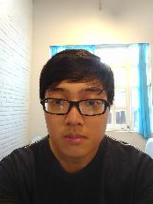


Problem
Person List
Ngọc Hoàng
Hoàng Sơn

Slide 177
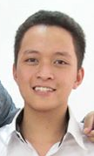
Problem
Person List
Ngọc Hoàng
+
Hoàng
Hoàng Sơn

Slide 178
Problem
Person List
Person List
Ngọc Hoàng
Ngọc Hoàng
+
Hoàng
Hoàng Sơn
Hoàng Sơn
Hoàng

Slide 179
Problem
Person List
Person List
Ngọc Hoàng
Ngọc Hoàng
+
Hoàng
Hoàng Sơn
Hoàng Sơn
Hoàng
Notes:
Việc có cùng 1 người mà được lưu thành nhiều person trong person list làm giảm performance của phần mềm vì khi detect người phải so sánh thêm 1 person nữa

Slide 180
Our Proposal

Slide 181
Our Proposal
System

Slide 182
Our Proposal
Find Duplicated Persons By Faces in the Person Group
System

Slide 183
Our Proposal
Find Duplicated Persons By Faces in the Person Group
System
Display the result to user

Slide 184
Our Proposal
Find Duplicated Persons By Faces in the Person Group
System
User can now group duplicated persons into 1
Display the result to user

Slide 185
How can we do that ?
Notes:
Face Verify: Kiểm tra, xác thực xem gương mặt có thuộc về người được truyền vào hay không?
Output:
- Is Identical: Kết quả của việc kiểm tra xác minh
- Confidence: 1 con số thể hiện độ trùng khớp giữa gương mặt và person được đưa vào. ( Mặc định > 0.5 thì là identical )

Slide 186
How can we do that ?
Microsoft Cognitive Service
Face - Verify
Verify whether one face belongs
to a person
Notes:
Face Verify: Kiểm tra, xác thực xem gương mặt có thuộc về người được truyền vào hay không?
Output:
- Is Identical: Kết quả của việc kiểm tra xác minh
- Confidence: 1 con số thể hiện độ trùng khớp giữa gương mặt và person được đưa vào. ( Mặc định > 0.5 thì là identical )

Slide 187
How can we do that ?
INPUT
- Face ID
- Person Group ID
Microsoft Cognitive Service
- Person ID
Face - Verify
Verify whether one face belongs
to a person
Notes:
Face Verify: Kiểm tra, xác thực xem gương mặt có thuộc về người được truyền vào hay không?
Output:
- Is Identical: Kết quả của việc kiểm tra xác minh
- Confidence: 1 con số thể hiện độ trùng khớp giữa gương mặt và person được đưa vào. ( Mặc định > 0.5 thì là identical )

Slide 188
How can we do that ?
INPUT
OUTPUT
- Face ID
- Is Identical?
- Person Group ID
Microsoft Cognitive Service
- Confidence
- Person ID
Face - Verify
Verify whether one face belongs
to a person
Notes:
Face Verify: Kiểm tra, xác thực xem gương mặt có thuộc về người được truyền vào hay không?
Output:
- Is Identical: Kết quả của việc kiểm tra xác minh
- Confidence: 1 con số thể hiện độ trùng khớp giữa gương mặt và person được đưa vào. ( Mặc định > 0.5 thì là identical )

Slide 189
How can we do that ?
Confidence Research: Verifying 100 faces of a man model
Notes:
Face Verify: Kiểm tra, xác thực xem gương mặt có thuộc về người được truyền vào hay không?
Output:
- Is Identical: Kết quả của việc kiểm tra xác minh
- Confidence: 1 con số thể hiện độ trùng khớp giữa gương mặt và person được đưa vào. ( Mặc định > 0.5 thì là identical )

Slide 190
How can we do that ?
Confidence Research: Verifying 100 faces of a man model
Range | Count
0.9 – 1 | 1
0.8 – 0.9 | 9
0.7 – 0.8 | 55
0.6 – 0.7 | 31
0.5 – 0.6 | 4
< 0.5 | 0

Slide 191
How can we do that ?
Confidence Research: Verifying 100 faces of a man model
Range | Count
0.9 – 1 | 1
0.8 – 0.9 | 9
0.7 – 0.8 | 55
0.6 – 0.7 | 31
0.5 – 0.6 | 4
< 0.5 | 0
Matched Confidence
0.65
Notes:
Face Verify: Kiểm tra, xác thực xem gương mặt có thuộc về người được truyền vào hay không?
Output:
- Is Identical: Kết quả của việc kiểm tra xác minh
- Confidence: 1 con số thể hiện độ trùng khớp giữa gương mặt và person được đưa vào. ( Mặc định > 0.5 thì là identical )

Slide 192



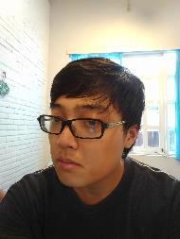

How can we do that ?
Person List
Ngọc Hoàng
Hoàng Sơn
Hoàng

Slide 193
Person Identification
How can we do that ?
System

Slide 194






Person Identification
How can we do that ?
Person List
Hoàng
1. Sort
Ngọc Hoàng
System
Hoàng Sơn

Slide 195
Person Identification
How can we do that ?
Person List
Hoàng
2. Select each face of each person to compare with other persons.
1. Sort
Ngọc Hoàng
System
Hoàng Sơn

Slide 196
Person Identification
How can we do that ?
Person List
Hoàng
2. Select each face of each person to compare with other persons.
3. Send
data
1. Sort
Ngọc Hoàng
System
Microsoft Cognitive Service
Hoàng Sơn

Slide 197
Person Identification
How can we do that ?
4. Verify faces and persons
Person List
Hoàng
2. Select each face of each person to compare with other persons.
3. Send
data
1. Sort
Ngọc Hoàng
System
Microsoft Cognitive Service
Hoàng Sơn

Slide 198
Person Identification
How can we do that ?
4. Verify faces and persons
Person List
Hoàng
2. Select each face of each person to compare with other persons.
3. Send
data
1. Sort
Ngọc Hoàng
System
Microsoft Cognitive Service
Hoàng Sơn
5. Return IsIdentical & Confidence Value

Slide 199
Person Identification
How can we do that ?
4. Verify faces and persons
Person List
Hoàng
2. Select each face of each person to compare with other persons.
3. Send
data
1. Sort
Ngọc Hoàng
System
Microsoft Cognitive Service
Hoàng Sơn
5. Return IsIdentical & Confidence Value
6. Process

Slide 200
Person Identification
How can we do that ?
4. Verify faces and persons
Person List
Hoàng
2. Select each face of each person to compare with other persons.
3. Send
data
1. Sort
Ngọc Hoàng
System
Microsoft Cognitive Service
Hoàng Sơn
5. Return IsIdentical & Confidence Value
Result
Hoàng
6. Process
7. Display result
Ngọc Hoàng
User

Slide 201
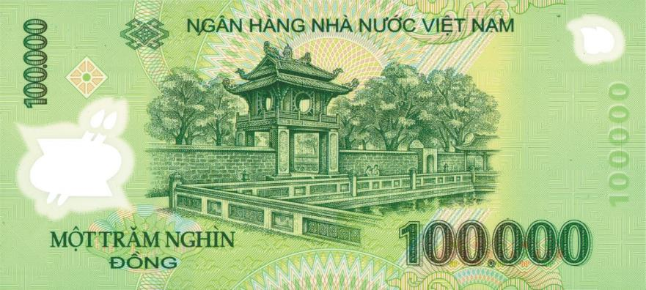
Object recognitive
Problem
How much is it?
Mr. Quan

Slide 202
Object recognitive
Our Proposal

Slide 203
Object recognitive
Our Proposal
System

Slide 204
Object recognitive
Our Proposal
Detect Object
System

Slide 205
Object recognitive
Our Proposal
Describe information back to the blind
Detect Object
System

Slide 206
Object recognitive
Our Proposal
Describe information back to the blind
Detect Object
System
The blind know what it is

Slide 207
Object recognitive
Our Proposal
Describe information back to the blind
Detect Object
System
Blind can do right thing with it
The blind know what it is

Slide 208
Object recognitive
How can we do that ?

Slide 209

Object recognitive
How can we do that ?
1. Capture Picture
Camera

Slide 210
Object recognitive
How can we do that ?
1. Capture Picture
Camera
System

Slide 211

Object recognitive
How can we do that ?
2. Send Image
1. Capture Picture
Camera
System
3. Response Result
Clarifai Service

Slide 212
Object recognitive
How can we do that ?
2. Send Image
1. Capture Picture
Camera
System
3. Response Result
Clarifai Service
4. Process

Slide 213
Object recognitive
How can we do that ?
2. Send Image
1. Capture Picture
Camera
System
3. Response Result
Clarifai Service
4. Process
5. Describe
Blind user

Slide 214
Object recognitive
Technology

Slide 215

Object recognitive
Technology

Slide 216
Object recognitive
Technology
Detect faces, colors,

Slide 217
Object recognitive
Technology
Detect faces, colors,
Custom training

Slide 218
Object recognitive
Technology
Detect faces, colors,
Custom training
Search images

Slide 219
Object recognitive
Technology
How it works?

Slide 220
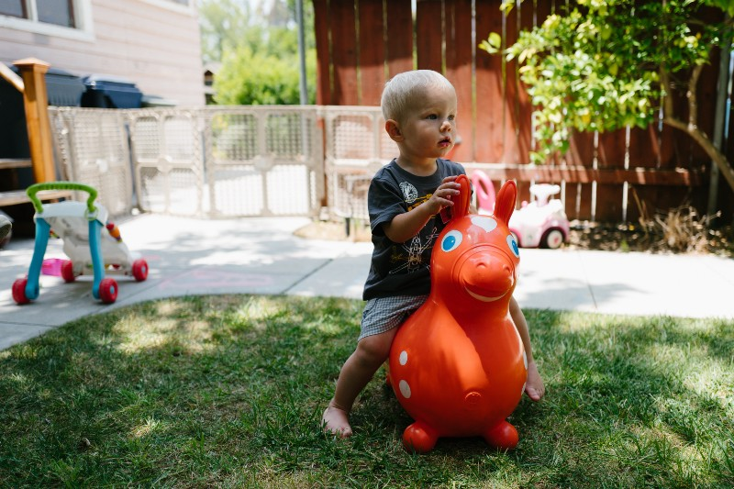
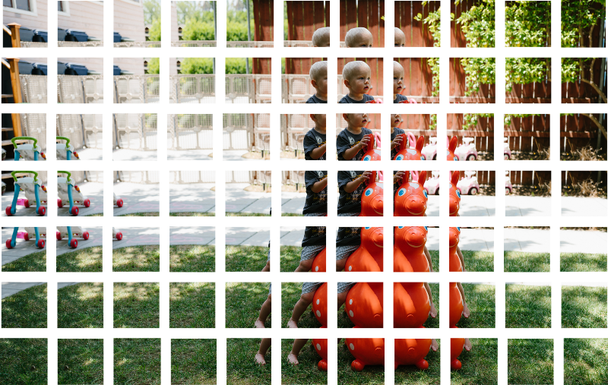
Object recognitive
Technology

Slide 221

Object recognitive
Technology

Slide 222
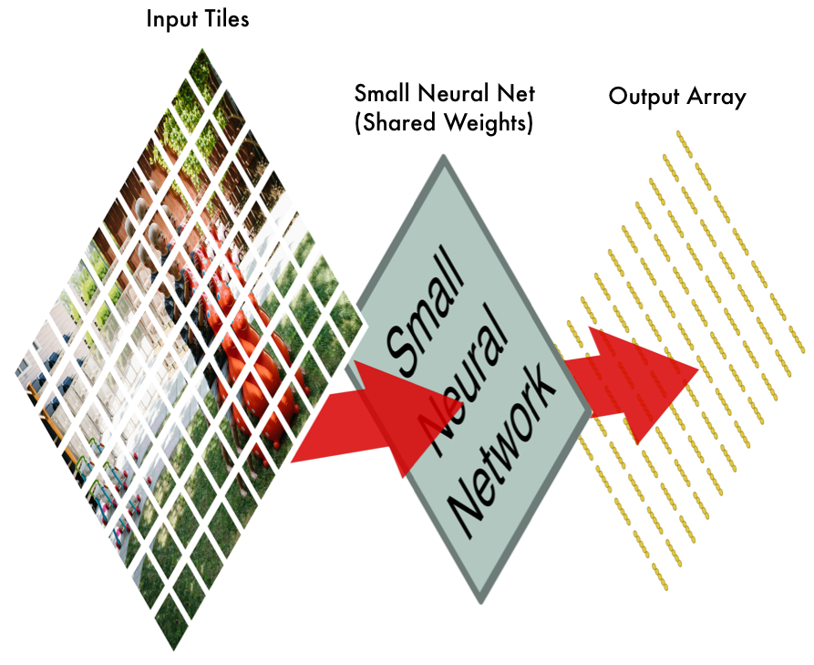
Object recognitive
Technology

Slide 223
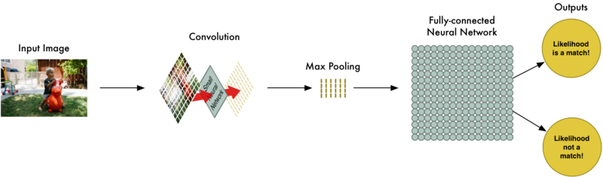
Object recognitive
Technology

Slide 224
Object recognitive
Technology
How can Clarifai service recognitive a things ?

Slide 225
Object recognitive
Technology
Training Process

Slide 226
Object recognitive
Technology
Training Process
Create Concept

Slide 227
Object recognitive
Technology
Training Process
Create Concept
Add Image to Concept

Slide 228
Object recognitive
Technology
Training Process
Create Concept
Add Image to Concept
Training

Slide 229
Object recognitive
Technology
Understand Terms

Slide 230
Object recognitive
Technology
Understand Terms
Model

Slide 231
Object recognitive
Technology
Understand Terms
Model
Concept

Slide 232
Object recognitive
Technology
Understand Terms
Model
Concept
Input

Slide 233
Object recognitive
Technology
Understand Terms
Model
Concept
Input

Slide 234
Object recognitive
Understand Terms
Model

Slide 235
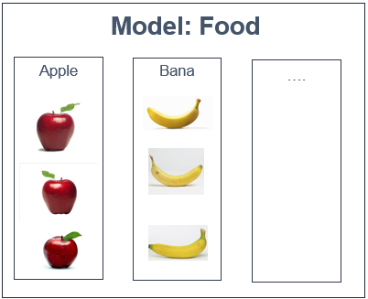
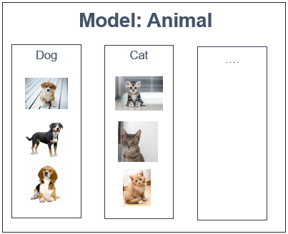
Object recognitive
Understand Terms
Model

Slide 236
Object recognitive
Understand Terms
Model
Model have unique Model ID

Slide 237
Object recognitive
Understand Terms
Model
Model have unique Model ID
Group input(eg. images) to predictions

Slide 238
Object recognitive
Understand Terms
Model
Model have unique Model ID
Group input(eg. images) to predictions
Unique set of outputs(eg. Dog, Cat)

Slide 239
Object recognitive
Understand Terms
Concept

Slide 240
Object recognitive
Understand Terms
Concept
Concept

Slide 241
Object recognitive
Understand Terms
Concept
Concept
Belong to a unique Model

Slide 242
Object recognitive
Understand Terms
Concept
Concept
Belong to a unique Model
Have a unique Concept ID

Slide 243
Object recognitive
Understand Terms
Concept
Concept
Belong to a unique Model
Have a unique Concept ID
Have Name, Description

Slide 244
Object recognitive
Understand Terms
Concept
Concept
Belong to a unique Model
Have a unique Concept ID
Have Name, Description
Have up to 10 concepts(free plan)

Slide 245
Object recognitive
Understand Terms
Input

Slide 246
Object recognitive
Understand Terms
Input
Input
Notes:
Get your free API key
Search and predict
5,000 free operations per month
10,000 free inputs
Train your own model
10 free custom concepts
Standard
Outgrown the free tier? Pay as you go.
Sign Up
Search and predict
5,000 free operations per month
$1.20 per 1,000 operations
10,000 free inputs
$0.80 per 1,000 inputs per month
Train your own model
10 free custom concepts
$0.46 per concept, per month
$3.20 per 1,000 custom predict operations
Enterprise

Slide 247
Object recognitive
Understand Terms
Input
Have a unique Input ID
Input
Notes:
Get your free API key
Search and predict
5,000 free operations per month
10,000 free inputs
Train your own model
10 free custom concepts
Standard
Outgrown the free tier? Pay as you go.
Sign Up
Search and predict
5,000 free operations per month
$1.20 per 1,000 operations
10,000 free inputs
$0.80 per 1,000 inputs per month
Train your own model
10 free custom concepts
$0.46 per concept, per month
$3.20 per 1,000 custom predict operations
Enterprise

Slide 248
Understand Terms
Input
Have a unique Input ID
Have up to 10000 inputs(free plan)
Input
Notes:
Get your free API key
Search and predict
5,000 free operations per month
10,000 free inputs
Train your own model
10 free custom concepts
Standard
Outgrown the free tier? Pay as you go.
Sign Up
Search and predict
5,000 free operations per month
$1.20 per 1,000 operations
10,000 free inputs
$0.80 per 1,000 inputs per month
Train your own model
10 free custom concepts
$0.46 per concept, per month
$3.20 per 1,000 custom predict operations
Enterprise

Slide 249
Technology
Training Process
Create Concept
Add Image to Concept
Training

Slide 250
Object recognitive
Technology
Training Process
Create Concept
Add Image to Concept
Training

Slide 251

Object recognitive
Create New Concept
Clarifai Service
System
1. Input
Name
Description

Slide 252
Object recognitive
Create New Concept
Clarifai Service
System
Model
Concept
1. Input
Concept Id
Name
Description
Name
Description

Slide 253
Object recognitive
Create New Concept
Clarifai Service
System
Model
Concept
2. Create Concept
1. Input
Concept Id
Name
Description
Name
Description

Slide 254
Object recognitive
Create New Concept
Clarifai Service
System
Model
Model
Concept
Concept
2. Create Concept
1. Input
Concept Id
Name
Description
Name
Description
Name
Description

Slide 255
Object recognitive
Create New Concept
Clarifai Service
System
Model
Model
Concept
Concept
2. Create Concept
1. Input
Concept Id
Name
Description
Name
Description
Name
Description
3. Concept information

Slide 256
Object recognitive
Technology
Training Process
Create Concept
Add Image to Concept
Training

Slide 257
Create New Input
Clarifai Service
System
Model
Model
Concept
Concept
Concept ID
Name
Description
Concept ID
Name
Description

Slide 258

Object recognitive
Create New Input
Clarifai Service
System
Model
Model
Concept
Concept
1. Input
Concept ID
Name
Description
Concept ID
Name
Description

Slide 259
Object recognitive
Create New Input
Clarifai Service
System
Model
Model
Concept
Concept
2. Send
1. Input
Concept ID
Name
Description
Concept ID
Name
Description
Concept ID
Model ID

Slide 260
Object recognitive
Create New Input
Clarifai Service
System
Model
Model
Concept
Concept
2. Send
1. Input
Concept ID
Name
Description
Concept ID
Name
Description
Concept ID
Input
Model ID

Slide 261
Object recognitive
Create New Input
Clarifai Service
System
Model
Model
Concept
Concept
2. Send
1. Input
Concept ID
Name
Description
Concept ID
Name
Description
Concept ID
Input
Model ID
3. Return
Input ID

Slide 262
Object recognitive
Create New Input
Clarifai Service
System
Model
Model
Concept
Concept
2. Send
1. Input
Concept ID
Name
Description
Concept ID
Name
Description
Input
Concept ID
Input
Model ID
Input ID
3. Return
Input ID

Slide 263
Object recognitive
Technology
Training Process
Create Concept
Add Image to Concept
3. Training

Slide 264
Object recognitive
Create New Input
Clarifai Service
System
Model

Slide 265
Object recognitive
Create New Input
Clarifai Service
System
Model
1. Train

Slide 266
Object recognitive
Create New Input
Clarifai Service
System
Model
2. Send
Model ID
1. Train

Slide 267

Object recognitive
Create New Input
Clarifai Service
System
Model
Model
2. Send
Model ID
1. Train
Train Model

Slide 268
Object recognitive
Create New Input
Clarifai Service
System
Model
Model
2. Send
Model ID
1. Train
3. Return Status
Train Model

Slide 269
Object recognitive
Create New Input
Clarifai Service
System
Model
Model
2. Send
Model ID
1. Train
3. Return Status
4. Notify
Train Model

Slide 270
Object recognitive
Technology
Training Process
Create Concept
Add Image to Concept
Training

Slide 271
Demo

Slide 272
Future Plan
Support multipla platforms: iOS, Window phone or smart glasses

Slide 273





Technologies

Slide 274






Devlopment Environment

